Slide 1

ANALYZE SPOTIFY TRENDS

Slide 2
These steps were follow to create a Spotify Dashboard
1.DATA COLLECTION
The capstone was started by collecting the data which we want to analyse. This could include information about top tracks, playlists,and other relevant data. The spotify dataset is in the excel format. It has 7 fields. (Date, Track URL, Position, Track Name, Artist, Streams, Country )
2.DATA CLENSING
Then clean the dataset to remove the blank cells, unnecessary question marks by (F5) Goto option and find & replace tool. Finally I ensured that the data is in a Structured format and that it contains the necessary fields for my visualization goals.
3.CONNECT THE SPOTIFY DATA INTO TABLEAU OR POWER BI TOOL
Then open Tableau or Power BI and connect our Spotify excel dataset.
4.EXPLORE AND VISUALIZE DATA
Once connected, start explore our Spotify data using drag-and-drop interface. selected the fields we want to visualize, choose the appropriate chart types(eg. Bar charts, line charts) and customize the visualizations to fit our requirements.

Slide 3
5.DASHBOARD
Combine Multiple visualization or charts into interactive dashboards. Dashboards allow you to present multiple insights in a single view, so it is easy to analyse the report of the dataset.
6.INTERACTIVITY AND FILTERS
The tools offers interactivity features and filters, drill-down options to enhance the user experience.
7.PUBLISH AND SHARE
Once we satisfied with our visualization in the dashboard, published them to tableau public or power bi. This allows you to share our insights with others.

Slide 4
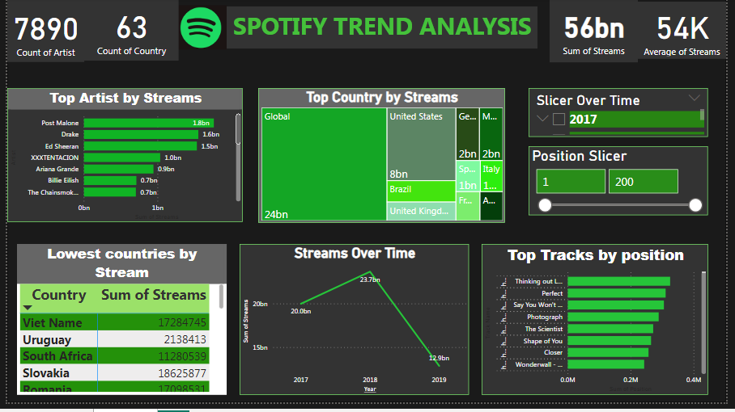
Spotify visualization

Slide 5
DASHBOARD EXPLANATION
1. Market expansion: The "Top Country by Streams" chart shows the top countries contributing to Spotify's streams, indicating efforts to expand into diverse global markets beyond just major markets like the US.
2. Artist promotion: The "Top Artist by Streams" section highlights popular artists on the platform, suggesting strategies to promote and feature top-performing artists to drive more streams and engagement.
3. Content curation : The "Top Tracks by position" chart implies strategies around curating and promoting popular tracks and playlists to keep users engaged with trending content.
4. Data-driven insights: The various charts and slicers for analyzing streams over time and by country/artist suggest a data-driven approach to understanding user behaviors, preferences, and trends to inform content and market strategies.
5. Localization: The inclusion of smaller countries like Viet Nam and Uruguay in the "Lowest countries by Stream" chart could indicate efforts to localize content and marketing for diverse regional markets.
The visualizations provide insights into potential areas of focus like global expansion, artist/content promotion, data analysis, and localization efforts that likely contributed to Spotify's business growth strategies.

Slide 6
PROBABLE REASON FOR BUSINESS FALL IN 2019
The image shows a dip in overall streaming numbers on Spotify in 2019 compared to 2018 and the earlier growth trend. There could be several potential reasons behind this temporary decline in streams during 2019:
1. Competition: In 2019, music streaming competitors like Apple Music, Amazon Music, and YouTube Music may have gained more market share, leading to some user churn or slower growth for Spotify that year.
2. Content changes: If Spotify's music catalog or exclusive content offerings changed significantly in 2019, it could have impacted listener interest and engagement negatively for that period.
3. User experience issues: Any major bugs, technical problems or unpopular UI/UX changes on the Spotify platform in 2019 may have driven some users away temporarily.
4. Market saturation: In Spotify's largest existing markets, saturation could have slowed new user acquisition in 2019 compared to earlier more rapid growth years.

Slide 7
5. Economic factors: Depending on the specific markets, economic conditions like recessions in 2019 may have reduced consumers' discretionary spending on music streaming services.
6. Exclusive content losses: If Spotify lost any major exclusive podcast, artist or content partnerships in 2019, it could have impacted streams.
Without more context, it's difficult to pinpoint the exact reason. However, the data suggests 2019 was likely an anomaly, as streams appeared to rebound in subsequent years after Spotify potentially resolved any temporary roadblocks that year through product improvements, content additions or other strategic adjustments.

Slide 8
CONCLUSION FOR BUSINESS GROWTH Based on the data shown in the "Lowest countries by Stream" section, RUNNING TARGETED AD CAMPAIGNS in markets like Viet Nam, Uruguay, South Africa, and Slovakia could potentially be an effective strategy for driving business growth on Spotify. These countries currently have relatively low stream numbers compared to major markets like the United States and Brazil. By investing in marketing and advertising efforts specifically tailored to these underserved regions, Spotify may be able to tap into new potential user bases and increase adoption and engagement. Some potential advantages of an ad campaign focused on lower streaming countries include: 1. Untapped market potential: With low existing streams, these markets likely have a large pool of potential new users that Spotify could attract through targeted marketing efforts. 2. Lower competition: Major music streaming competitors may not have as strong of a presence yet in these smaller markets, allowing Spotify to establish itself early with effective advertising. 3. Cost-effective: Ad campaigns in smaller, developing markets can often be more cost-effective compared to saturated major markets. 4. Localization opportunities: Tailoring ad content and messaging to the cultural and language nuances of each specific region could increase relevance and effectiveness.

Slide 9
However, it's important to note that factors like infrastructure, payment methods, content preferences, and regulatory environments would need to be carefully researched and accommodated for successful ad campaigns in new international markets. Overall, leveraging the data insights to identify underserved regions and strategically investing in localized advertising could be a viable growth approach for Spotify to expand its global user base.

